Slide 1

B2B RETURNS OPERATIONS MANAGEMENT SYSTEM
4/29/2021
OPIM 5272: Data Management and Business Process Modeling
University of Connecticut
MS in Business Analytics and Project Management
Notes:
Hello everyone! This is team 13 and Our presentation today is on B2B Returns Operations Management System.

Slide 2




Team 13
Abhinav Dubey
abd20003
Bhavya Bansal
bhb20004
Mayank Patidar
map20016
Priyanka Patel
prp20002
Notes:
Our team members include Bhavya Bansal, Mayank Patidar, Priyanka Patel and myself Abhinav Dubey. So let us begin.

Slide 3
01.
Company overview
04.
Workflow
02.
Business Problem
05.
Tables & Reports
03.
Proposed Solution
06.
Conclusion
Notes:
Before going over our project, we would like to share the agenda for today’s presentation. We’ll start with the Company Overview and explain the Business Problem followed by the Proposed Solution for the company. Then we will walk you through the Workflow of the proposed solution and will give you an overview of the tables and reports we created. Finally, we will conclude at the end.

Slide 4
COMPANY OVERVIEW
Our client is a B2B e-commerce platform and a credit lender.
It aggregates manufacturers, wholesalers, retailers, and traders to buy and sell products.
To facilitate easier commerce for SMEs, our client provides them with a credit line.
Being a growth startup, the company invests heavily in its logistics, operations, and financial services and stores huge amounts of data on it.
The B2B nature of the operation mean all loses related to returns, logistics, and operations must be kept at a minimum and all frauds should be identified at the earliest.
Notes:
Let me give you an overview of the company.
So our client is a B2B e-commerce platform and a credit lender.
It aggregates manufacturers, wholesalers, retailers, and traders to buy and sell products.
So to facilitate easier commerce for the subject matter experts our client provides them with a credit line. Being a growth startup, the company invests heavily in its logistics, operations, and financial services and stores huge amounts of data on it.
The B2B nature of the operation mean all loses related to returns, logistics, and operations must be kept at a minimum and all frauds should be identified at the earliest.

Slide 5
BUSINESS PROBLEM
In the current system,
The system is not unified. The information for all orders is stored at order line-item level. However, the information of all the returns is being stored at only return id level.
Identification of inefficient processes, subpar delivery vendors, warehouse management, and packaging etc. is currently inefficient and requires drastic improvement.
There is no provision to choose the return type. This makes the operations rigid and is a loss of opportunity for the firm in terms of logistics cost.
The company is losing a lot of money (in storage, transportation). This is because, sometimes, there is no longer the need of the item being ordered by the customer and so he doesn’t accept delivery.
Notes:
Now let's come to the business problem. The challenges and issues which are faced in the current system are
First is that the system is not unified. The information for all orders is stored at order line-item level. However, the information of all the returns is being stored at only return id level.
Second is Identification of inefficient processes, subpar delivery vendors, warehouse management, and packaging etc. is currently inefficient and requires drastic improvement.
Third is there is no provision to choose the return type. This makes the operations rigid and is a loss of opportunity for the firm in terms of logistics cost.
Lastly the company is losing a lot of money in storage and transportation. This is because, sometimes, there is no longer the need of the item being ordered by the customer and so he doesn’t accept delivery.
In the next slide we will see the different statistics related to the challenges and issues which are faced in the current system

Slide 6
$1,000,000+
That’s a lot of money to lose every month
That’s a lot of money
10,000+ users
Affected due to poor return management
And a lot of users
12%
Revenue as costs due to returns
Total success!
Notes:
So, the statistics are
More than one million dollars are lost every month and More than 10 thousand users face inconvenience due to poor return management.
The inefficiencies of the current return system amounts up to 12%.
To provide the solution for the business problem we reviewed the current system structural diagram of the database design which is Entity relationship diagram. Now Mayank will walk you through the current system ERD.

Slide 7
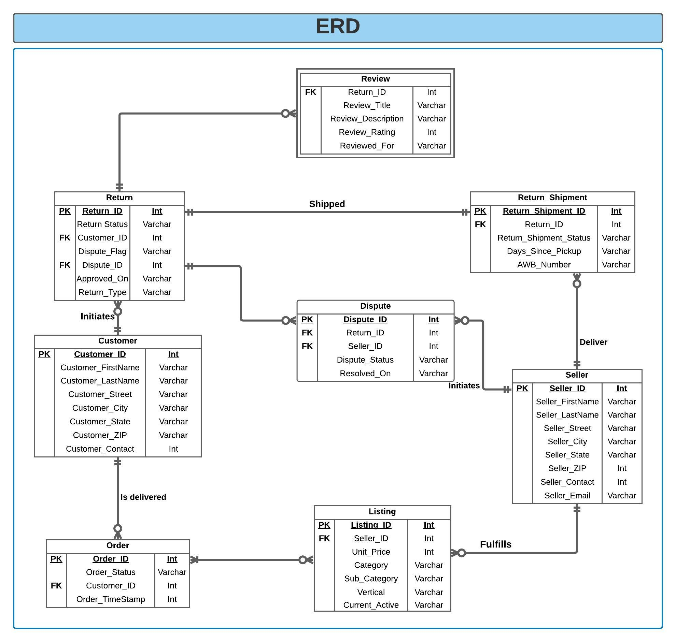
CURRENT ERD
Notes:
Thank you Abhinav for the initial overview of the project.
This ERD can be considered as the previous diagram that the company was following. Here as we can see for any order that is returned, there is an attribute Return ID which can give us the data of what product was returned. But there is no attribute like Return_Line_ID which can provide us the information of which items have been returned.
Further, there is no additional information on how a customer can accept or reject the delivery of the product he has received. [32 seconds]

Slide 8
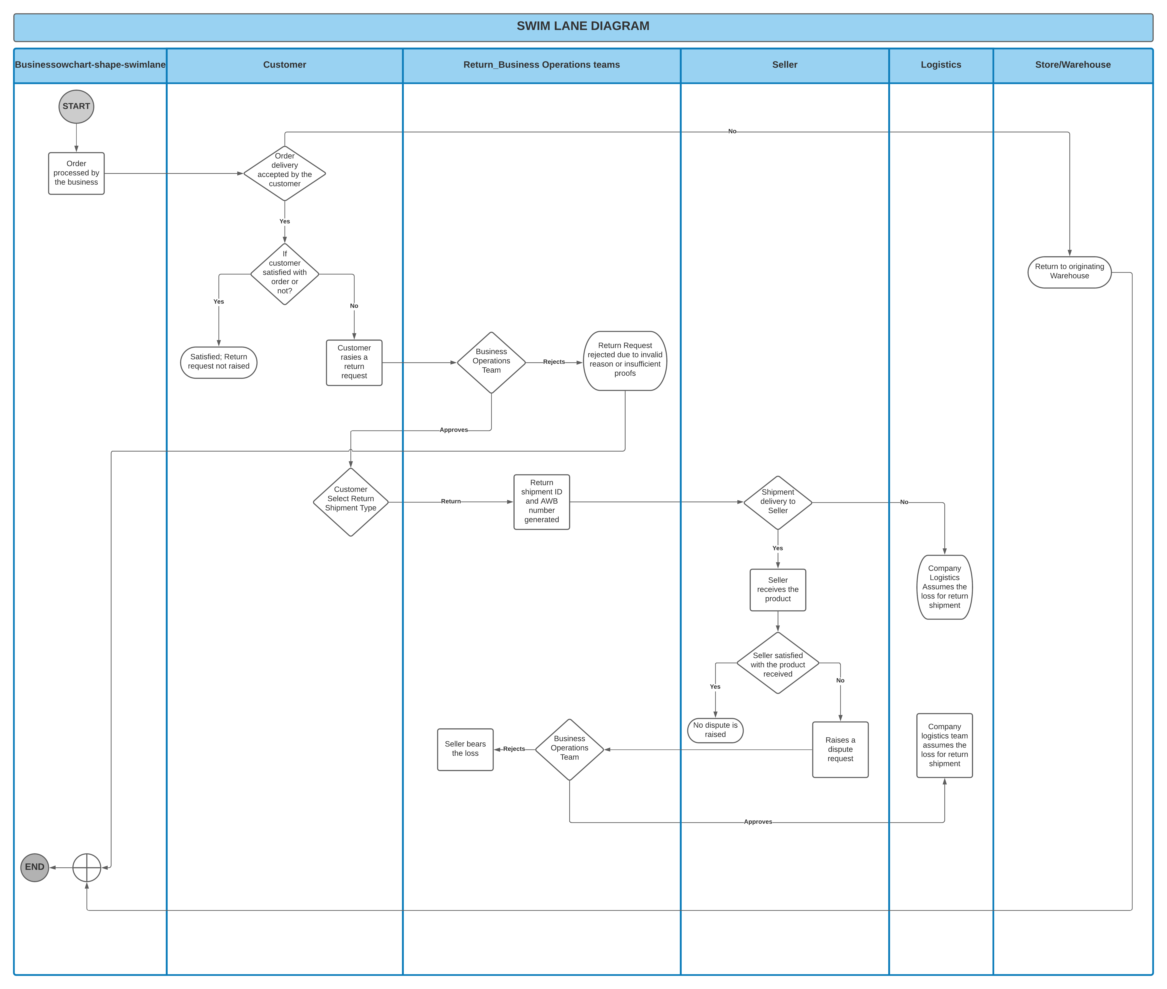
CURRENT SWINLANE
Business Owner | Customer | Returns_Business_Operations_Team | Seller | Logistics | Store/Warehouse
Notes:
This is the Swimlane diagram for the process flow of return, once the product is delivered to the customer, he can raise a return request if he is not satisfied with the product. The business operations team will handle the decisions of whether customer is eligible to get the full refund or not. If the customer is not happy with the quality of the product at the time of delivery itself, he can return the whole order back to the origin. [25 seconds]

Slide 9
PROPOSED SOLUTION
In the proposed system,
We have introduced a return line entity. Hence, this allowed us to bring all the information about the returns on the line-item level.
We introduced the concept of Partial RTO, wherein, at the time of delivery, the customer can decide which all items does he want to keep. If there is anything that he does not want to keep, a new invoice is made, and the unwanted items are taken back by the delivery person. This ensures that at least half of the company’s logistic expenditure is saved.
We identified three different return types – in store return, pickup exchange return and no pickup return.
Notes:
For the issues with return tracing, we have suggested some solutions and an additional feature to help both the parties involved in the process.
We have introduced a new return entity to breakdown the tracing of orders to line-item level. Previously if the customer wanted to return the parcel without accepting the delivery, he was forced to return the whole item to the origin, but with our proposed solution now a customer can easily accept a part of the order and return the remaining part to origin. This will help to save at least half of the company’s logistic expenditure. Further we have modified the return types into three different possible categories to simplify the return process. [ 42 seconds]

Slide 10
$700,000 +
Amount saved each month by addressing shortcomings
That’s a lot of money
1,000+ users
Potentially fraud user getting churned
And a lot of users
<2%
Revenue as costs due to returns
Total success!
Notes:
The Proposed system is estimated to make major improvements. We forsee a savings of more than 700k US dollars per month. Even though vendors are still affected, our analysis show 98% of these are potentially fraud vendors which we would be churned in the forthcoming audits. The final impact is less than 2% of the monthly revenues which is around 12% for the current system as mentioned by Abhinav previously. [ 28 seconds]

Slide 11
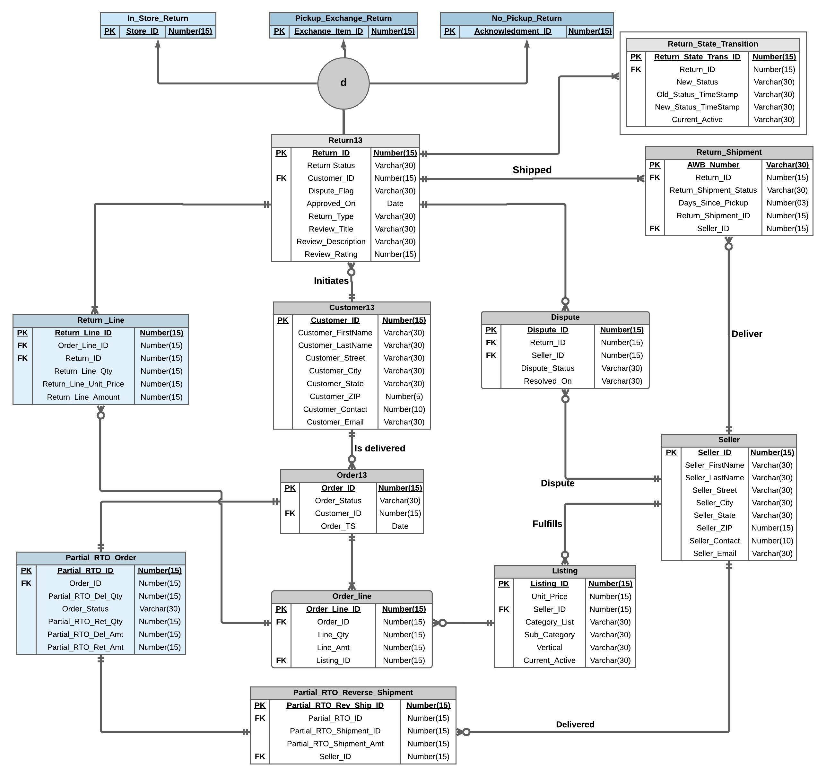
PROPOSED ERD
Notes:
This is the proposed ERD that we have created for the B2B company. We have sorted the issue of return_line_id by creating an additional table as Return_line which connects the dots from the return to Order.
This updated ERD has an associative entity Order_line that sorts the many to many relation between listing, order13 and return line. Further, we have classified the types of returns into subtypes in 3 categories that are in store return, pickup exchange return, and No pickup return just to simplify the return table. Further we have a weak entity relation of return_state_transition with return13 table. We have added an additional feature of Partial_RTO to make a partial return possible for any customer. [49 seconds]

Slide 12
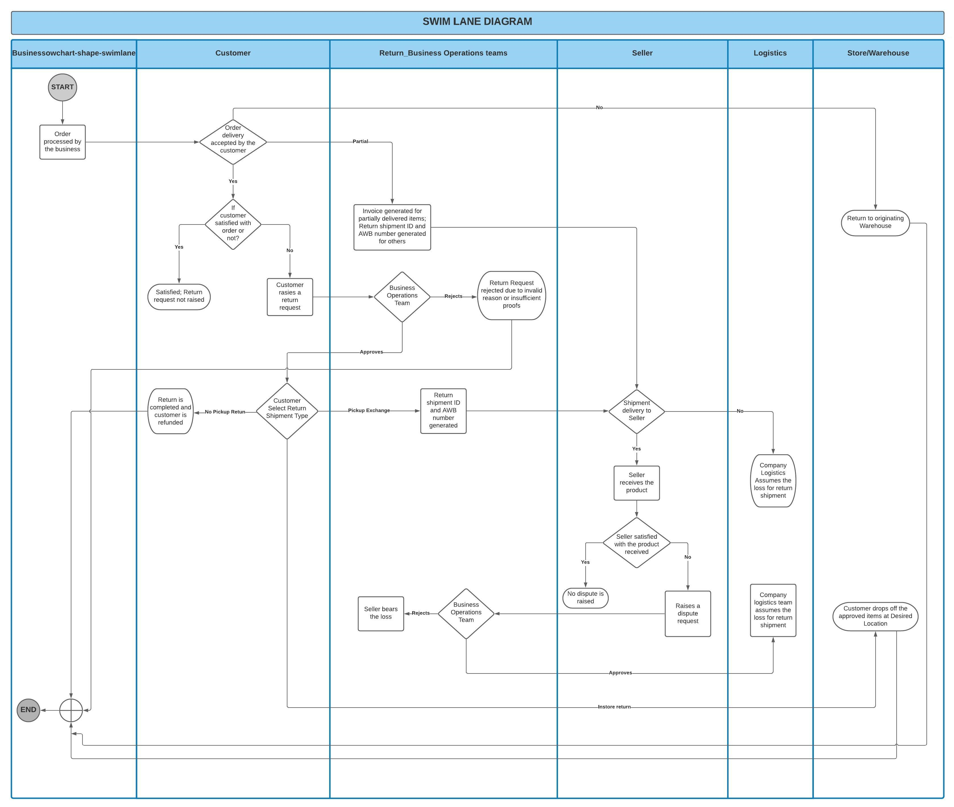
PROPOSED SWINLANE
Business Owner | Customer | Returns_Business_Operations_Team | Seller | Logistics | Store/Warehouse
Notes:
This is the proposed swimlane for our project, here this diagram has 6 actors and the process starts when a customer receives a product. If the order delivery is accepted by the customer and he is satisfied, then the return request is not generated. If he is not happy with the quality of the product. he can either partially return the order or fully return the order at the time of delivery, this was the feature that we have added.
Further, if he accepts the order at the time of delivery and in the allowed window of return he faces any issue, he can raise the return. Then the role of the Return Business operations team is to decide on whether the return request is acceptable and if acceptable what would be the next process after approval.
Now Bhavya will explain the workflow of the return process in detail. [50 seconds]

Slide 13
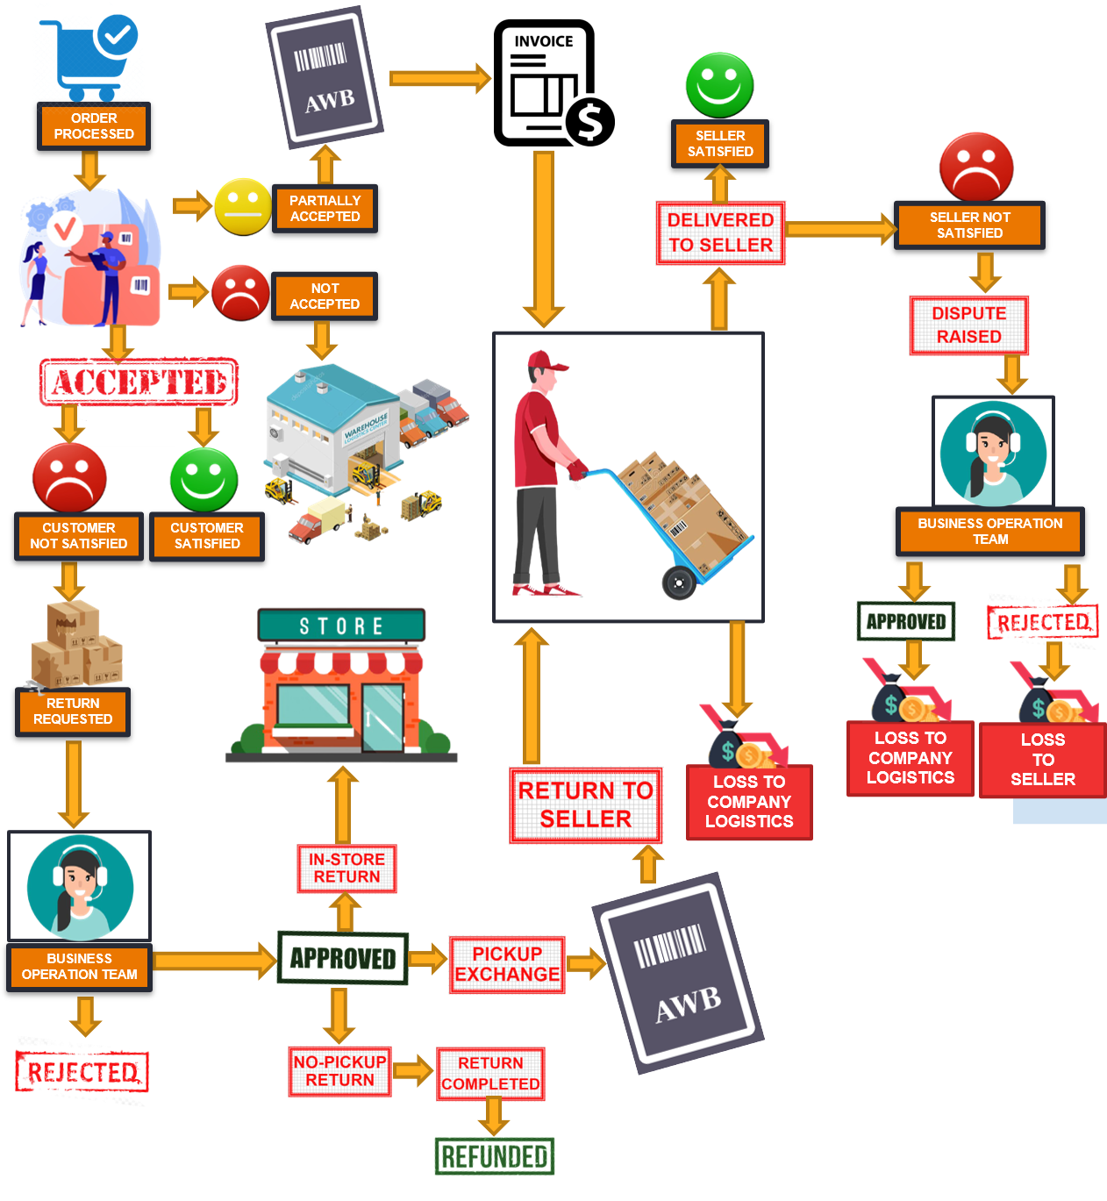
WORKFLOW
The illustration show the complete workflow of the proposed solution.
The start point for the workflow is “Order Processed”
Proposed solution workflow has many terminal points.
Notes:
Thank you Mayank for the introduction and taking us through the ERD and Swimlane diagram.
I will now explain the workflow of the proposed process and point out where the differences and improvements have been introduced compared to the current system.
The overall system on the current slide might seem overwhelming to begin with, however, it is composed of 3 major flows which I will be describing in detail in the following slides. These flows are buyer side flow, operations flow, and seller side flow.
The return process comes into consideration after the order is processed by the firm, and the delivery arrives at buyer's doorstep.

Slide 14
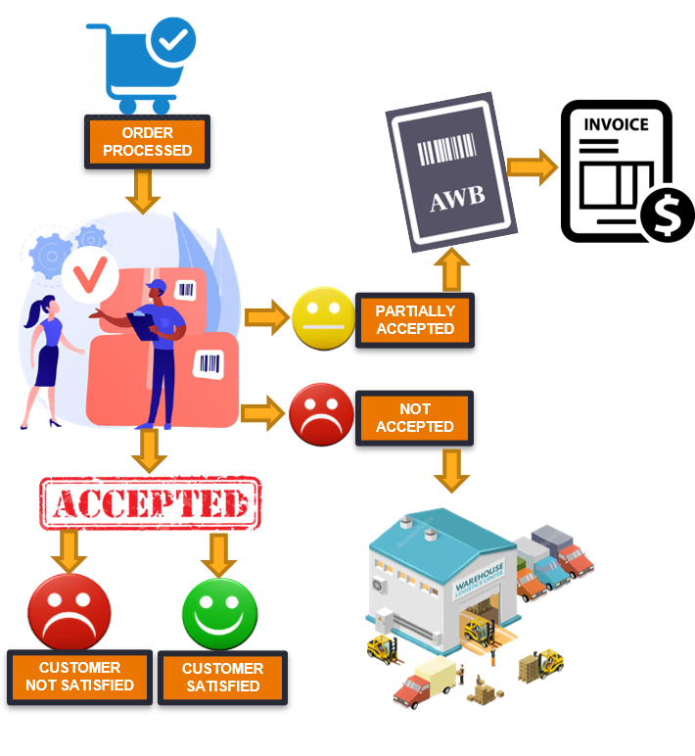
BUYER SIDE FLOW
The illustration shows the buyer side flow.
A buyer can reject the whole order, accept the whole order, or accept it partially.
If buyer accepts the order and isn’t happy, he can raise a return.
Notes:
Let’s delve deeper into the buyer side flow. Once the order arrives at the buyer, there are 3 possible outcomes from the perspective of the buyer that can be attributed to multiple reasons. These 3 outcomes are,
The buyer still wants the items in the order, and readily accepts the order. Once accepted, if satisfied, he would not raise any return. However, if unsatisfied with the order, he might raise a return on all or part of the order.
The buyer does not want the order in its entirety and denies any delivery. This situation is referred to as an RTO or Return To Origin.
The buyer does not want a few items he initially ordered; therefore, he tries to make an excuse and not accept the delivery. For this situation, we have introduced a new flow of Partial RTO. The buyer takes the delivery of the items he still needs, and a new invoice is created at the spot for the partially accepted order. The partial RTO flow is further linked to seller side flow, while the customer un-satisfaction is linked to operations flow.

Slide 15
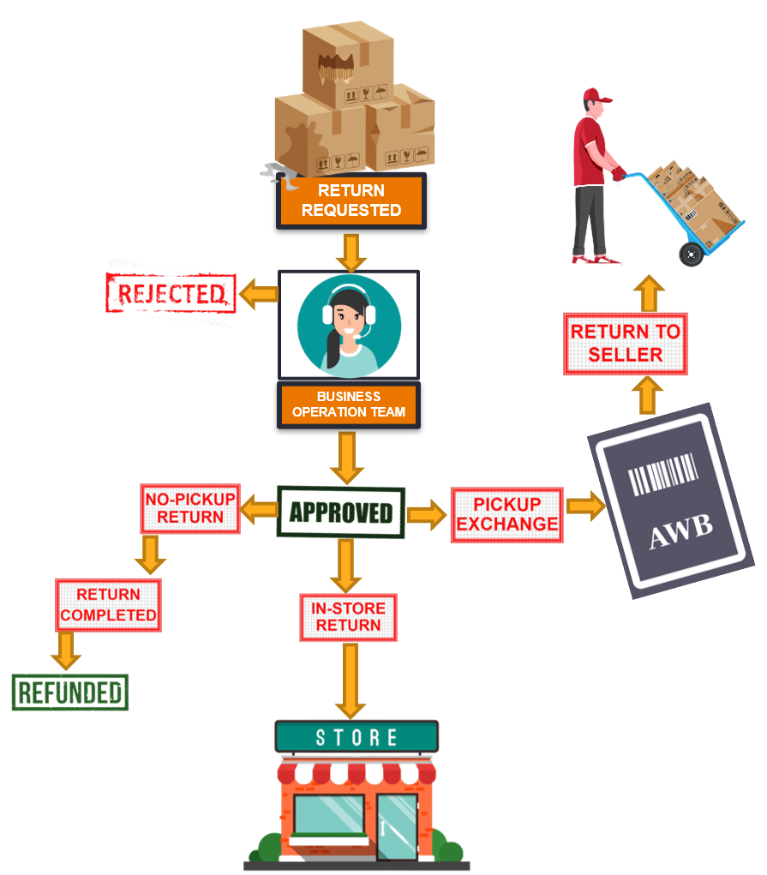
OPERATIONS FLOW
The illustration shows the operations flow. It is initiated if the buyer raises a return.
Return request is handled by an agent who can approve or reject the return.
Upon approving a return, a buyer has to select the type of return, and operations proceed from there.
Notes:
The operations flow is initiated when a customer is unsatisfied with his order and raises a return.
The return request reaches the business operations team. An agent calls the buyer to understand their concern with the order and asks for specific proofs basis which the return is either approved or rejected. A rejected return is a terminal stage.
Once the return is approved, the customer select from the available choices of completing the return cycle from buyer side. For returns eligible for no pickup due to missing items etc, return is completed as it is approved, and a refund is generated. For an instore return, the buyer can drop the item at their nearest warehouse or store affiliated to the firm. Once done, a refund is generated. For a pickup exchange, a pickup is scheduled basis which the buyer returns the item to the logistics team, which then creates a Airway Bill Number and ships the returned items back to the sellers. Once the return is picked up, a refund is generated against the return.
This flow also marks the end of any buyer involvement in the returns process.

Slide 16
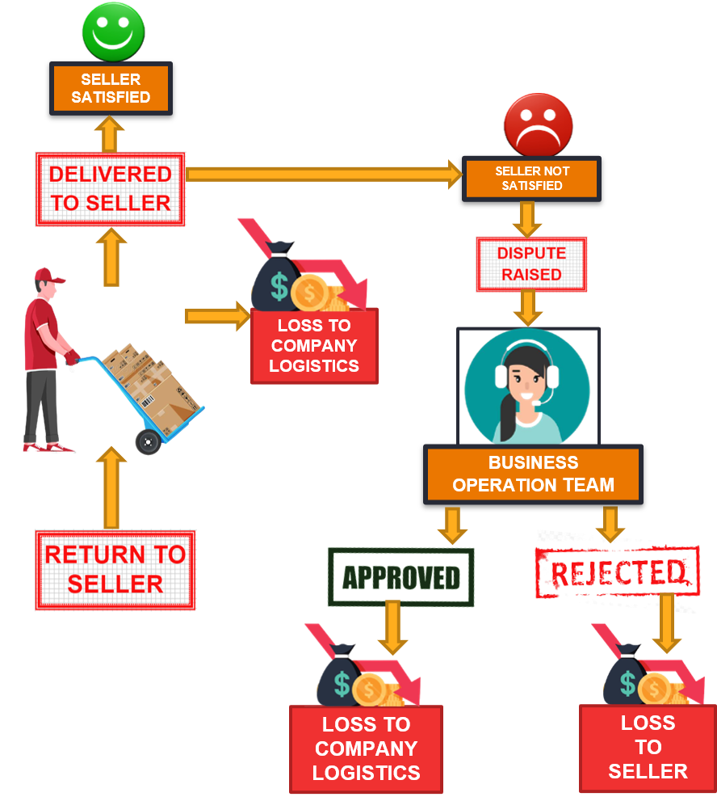
SELLER SIDE FLOW
The illustration shows the seller side flow. If the return type is pickup exchange, the return is delivered back to the seller.
A return can get lost or damaged during its shipment.
A seller can raise a dispute if he disagrees with the resolution.
Notes:
Lastly, the seller side flow comes into consideration when a return is shipped back to the seller whether it is a partial RTO or a normal return.
Before the item is delivered to the seller, it goes through the whole supply chain where inefficiencies can lead to loses. These loses can be attributed to losing the returned items, delaying the return beyond the return complete promise date etcetera. All of these are regarded as logistics loss that goes on the firm’s balance sheet.
Once the items are successfully returned to the seller, the seller may or may not agree with the return resolution. In case everything is in order and the seller is satisfied, the return is closed, and the seller absorbs the hit. Incase the seller is not happy with the resolution; he has the option to raise a dispute. The dispute request is forwarded to the business operation team, which then calls the seller, and decides to approve or reject the dispute based on its merit. The approval of a dispute is a loss to the firm while a rejection is a loss to the seller.
Now, Priyanka will be taking you through the next part of our presentation.

Slide 17
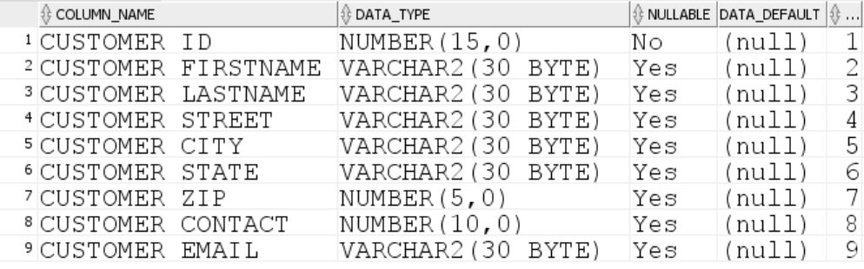
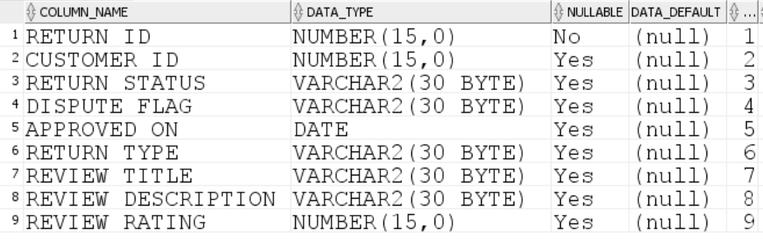
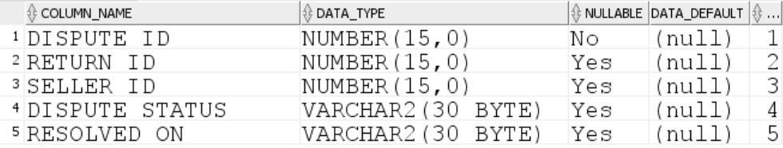
TABLES
Customer13
Seller
Listing
Order13
Order_Line
Partial_RTO_Order
Partial_RTO_Reverse_Shipment
Return13
In_Store_Return
Pickup_Exchange_Return
No_Pickup_Return
Return_State_Transition
Return_Shipment
Return_Line
Dispute
Notes:
Thank you Bhavya.
After sorting the ERD we started working on the data tables. Our project has 15 tables as listed. We manually created entries for each table on an Excel sheet. We then imported the Excel sheet data to the data tables in SQL. We ensured that the Primary key column is NOT null in all the tables.

Slide 18
Reports
Useful business insights that we can obtain through the new system developed:
Seller’s performance can be tracked and measured. A seller with high return can be detrimental to the business. Identifying such sellers early is beneficial to the business.
For the partial RTO orders, we can see how much value was to be delivered and how much were we be able to deliver.
We can identify the products which have maximum demand and those which are being returned the most.
Gives an aim for the timeline to target to complete a return to increase customer satisfaction. A better return experience increases customer engagement and trust with the platform and promotes healthy return behavior.
Notes:
Talking about the reports, these are the SQL queries which helps us get the desired insights and results from the data that we have. It involves usage of various SQL concepts like joins, aggregate functions, date functions, data manipulations and many more to connect and join various tables and obtain required information. In our case, we were able to get some useful business insights through the enhancements in the data structure. We can easily track seller’s performance now, as both order and return information is on the line-item level. A seller whose products have been returned the maximum number of times can be detrimental to the business. Next, through the information about Partial RTO orders, we can now see how much value was to be delivered and how much was actually accepted by the customer. This can help us evaluate the buyer behavior for certain products and thereby help us for logistic cost estimation and budgeting. We can also generate reports to identify the trend in product demand. Also, by evaluating the rankings and the days a return took to complete, we can see that quicker the return was completed, higher was the customer satisfaction. This gives an approximate idea to target completion of a return. A better return experience increases customer engagement and trust with the platform and promotes healthy return behavior.

Slide 19
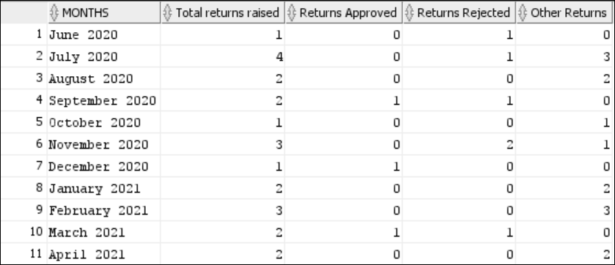
Report 1
Purpose: Customer perception of return as time taken to complete increases
Benefit: Derive insights to improve business performance
Use in Business: Gives an aim for the timeline to target to complete a return to increase customer satisfaction. A better return experience increases customer engagement and trust with the platform and promotes healthy return behavior.
Output:
Notes:
One of the most important reports that we were able to generate was an overall month on month data. This particular report gives us information about the total returns that were initiated in a month, and of that the total number of returns that were approved and rejected. Hence, this helps us track business performance. Too many rejected returns can lead to poor customer overview, whereas too less rejected returns can mean angry sellers and a poor profit/loss performance. It also helps us to figure out the issues, if any, within the return processes.

Slide 20
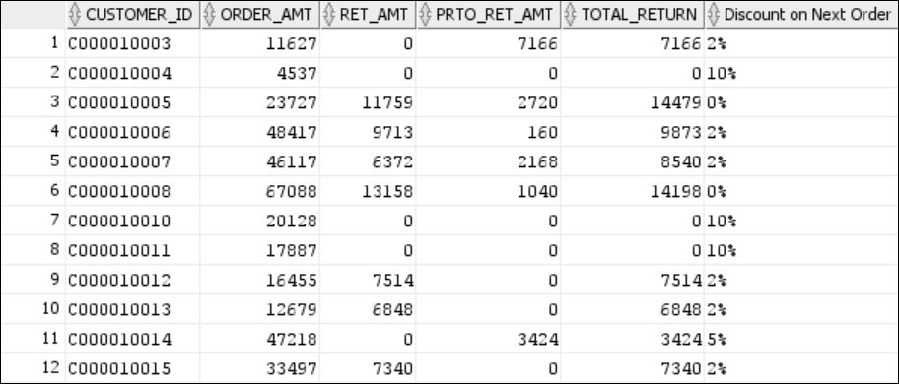
Report 2
Purpose: Incentivize customers for better return performance.
Benefit: Customer retention and promoting better buyers to spend more on the platform
Use in Business: Lesser the number of returns, better is the profit and loss statement of the company. Hence, in order to encourage a smaller number of returns, the company is planning to provide incentives to their customers based on their return history and ensuring they retain the business with them.
Output:
Notes:
The other useful insight that we were able to obtain through one of our reports was the total order amount versus total return amount per customer, which included both, normal returns as well as partial RTO. We know, lesser the number of returns, better is the profit and loss statement. Hence, in order to encourage a small number of returns, we developed an incentive plan for the customers, offering them discount based on their total return history. If the total return amount is less than 1000 dollars, they get 10% off on the next order. If it is between 1000 and 5000 dollars, then they get 5% off on their next order, if between 5000 and 10000 dollars, then 2% else 0%. This would improve the return performance, promoting better buyers to spend more on the platform and help us retain the business with them.

Slide 21
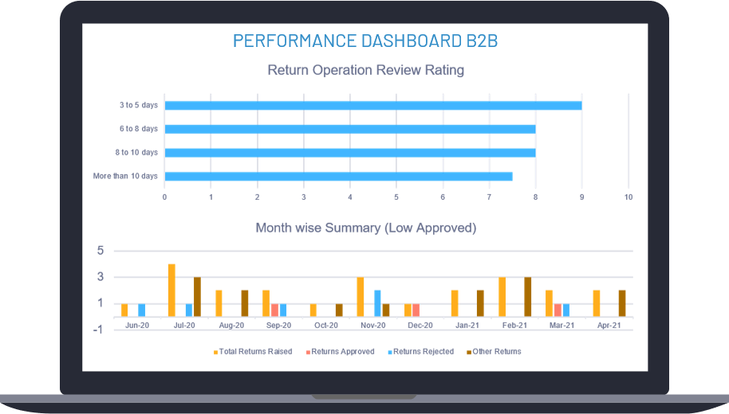
Sample Desktop Dashboard showcasing 2 important charts for the company to derive insights from.
Notes:
Based on the new data structure and the reports that we generated, we tried to create interactive visualizations that can help the company stakeholders derive useful insights easily.

Slide 22

CONCLUSION
We have made 3 major changes to the current process of B2B company.
Return line: Now the return process of items is done on return line level, i.e., individual items that are returned can be traced with the return line id.
Partial RTO: Now a customer can partially return the order to origin, this will help both seller and customer.
Return types: We can easily categories the returns basis in store return, pickup exchange return and no pickup return.
Notes:
Hereby, to conclude our presentation, we were able to identify the issues in the system and accordingly, propose a solution for that. We made three major changes in the system, i.e., bought the whole data on line item level by introducing return line id entity. Hence, now the return process of items can be done on return item level and all the individual items can be traced with their unique return line id. Moreover, by introducing the concept of Partial RTO, we were able to reduce the logistic expenditure. Also, by introducing 3 different categories of a normal return, we were further able to simplify the process. The SQL reports that we generated helped us to get clear business insights, enabling us to know the pain areas as well as the aspects where the company was performing really well.

Slide 23
THANK YOU!
ANY QUESTIONS?
And a lot of users
Notes:
We thank you for listening to our presentation. Please feel free to send us any questions or suggestions that you have for us. Thank you!

